Slide 1





Machine Learning Predictive Analytics Demo
What will the price of gas be next week?
Martin Madsen
Ph.D. in Experimental Physics
Experience working with sensors, data collection, data analysis, and predictive model building

Slide 2
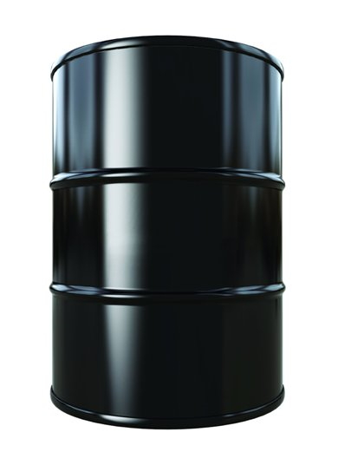
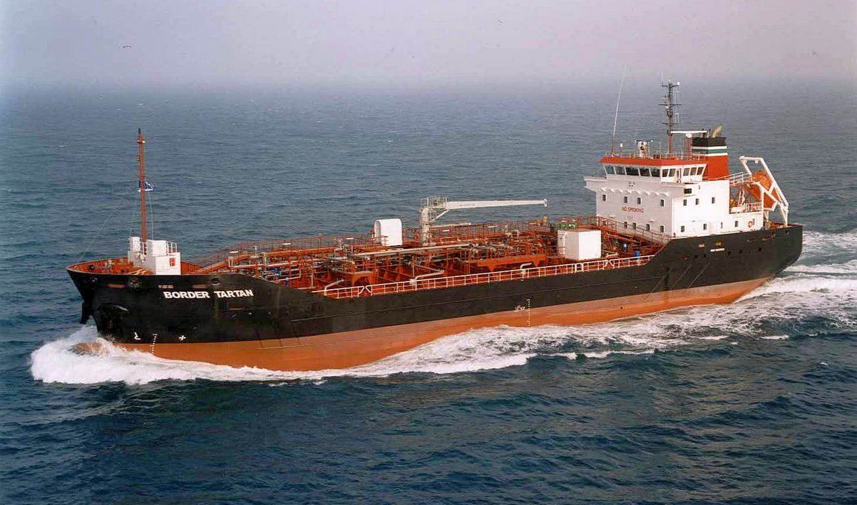



Input Prices
Imports/Exports
Inventory
Production
Sale Price

Slide 3
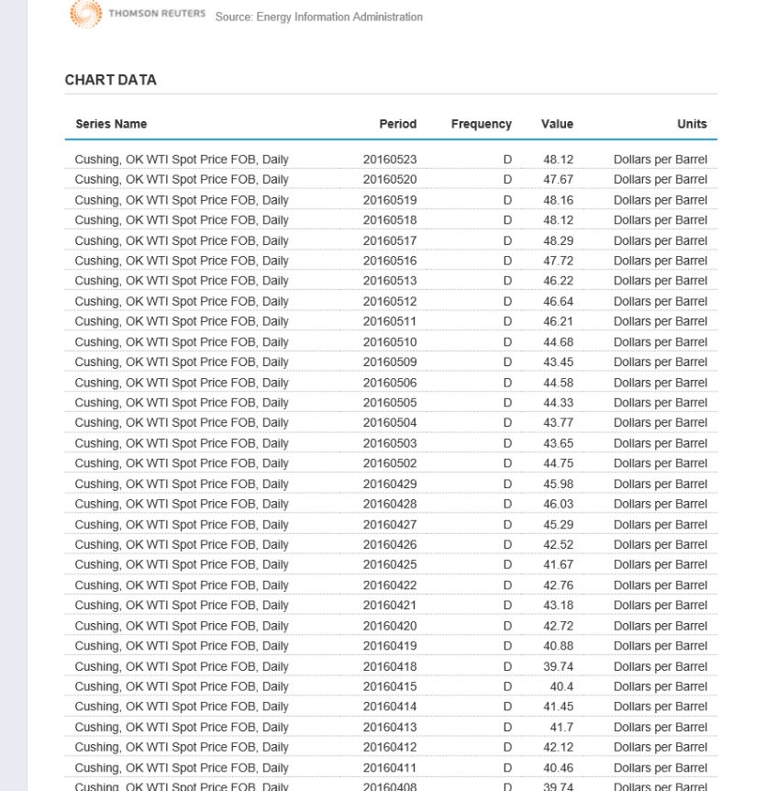
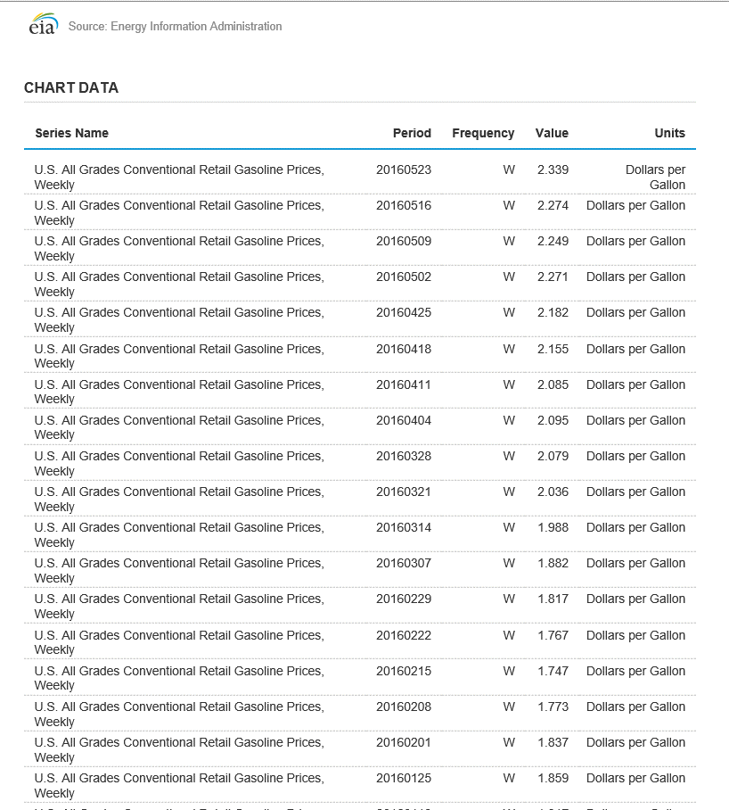
Web Table Data from U.S. Energy Information Administration (EIA)
http://www.eia.gov/opendata/qb.cfm?sdid=PET.RWTC.D
http://www.eia.gov/opendata/qb.cfm?sdid=PET.EMM_EPM0U_PTE_NUS_DPG.W

Slide 4




Azure Data Factory
Draw in data from Web tables

Slide 5
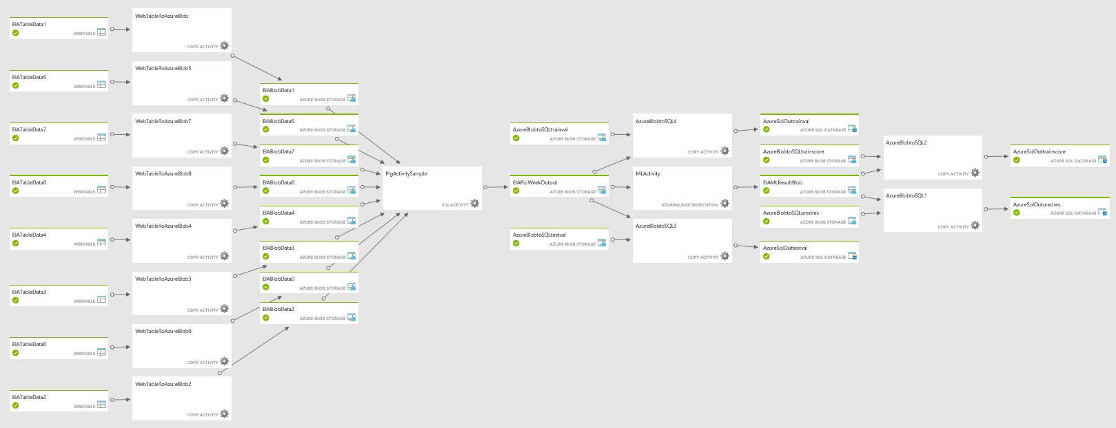
Azure Data Factory Pipeline
Web Table to Azure Blob

Slide 6
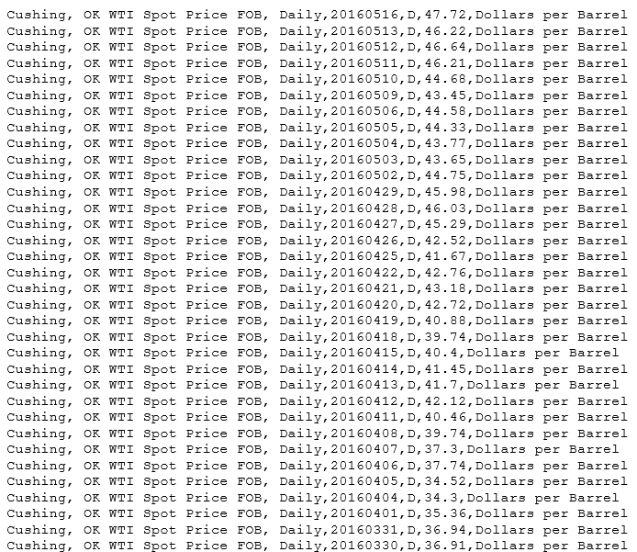
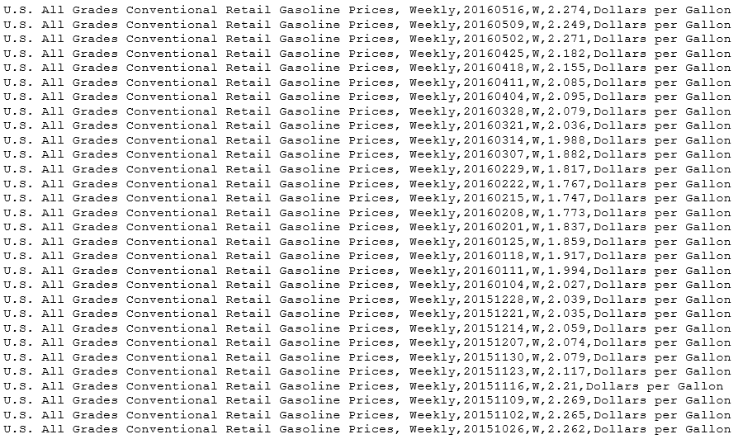
Output from Data Factory copy to Azure Blob Storage

Slide 7
Azure Data Factory
Draw in data from Web tables
Clean,
process,
join data
Pig script process on
HDInsight Cluster

Slide 8
Azure Data Factory Pipeline
Historical features for training model
Historical gas prices for training model
Pig Activity
Recent features for testing model
Recent prices for testing model

Slide 9
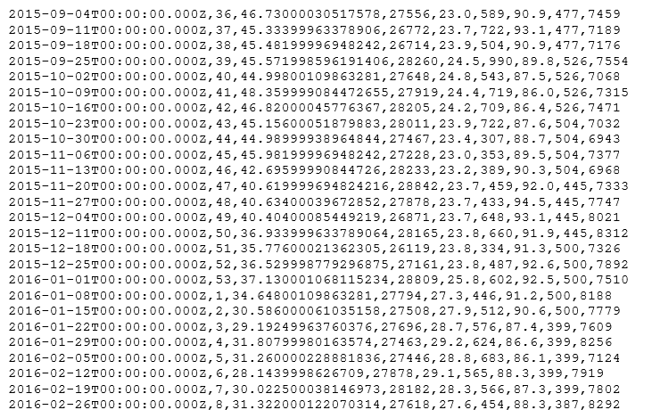
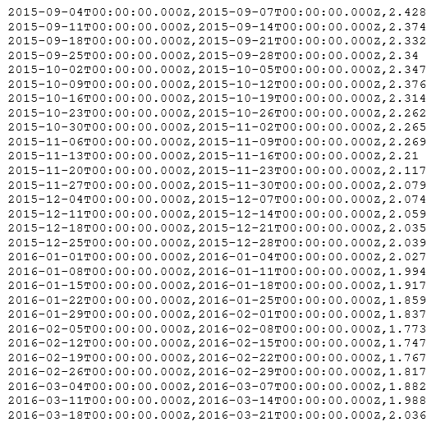
Output from Hadoop pig script
Historical features for training model
Historical gas prices for training model

Slide 10
Azure Machine
Learning
Store Joined
Data
Train model using
historical data
Azure Data Factory

Slide 11
Machine Learning Strategies

Slide 12
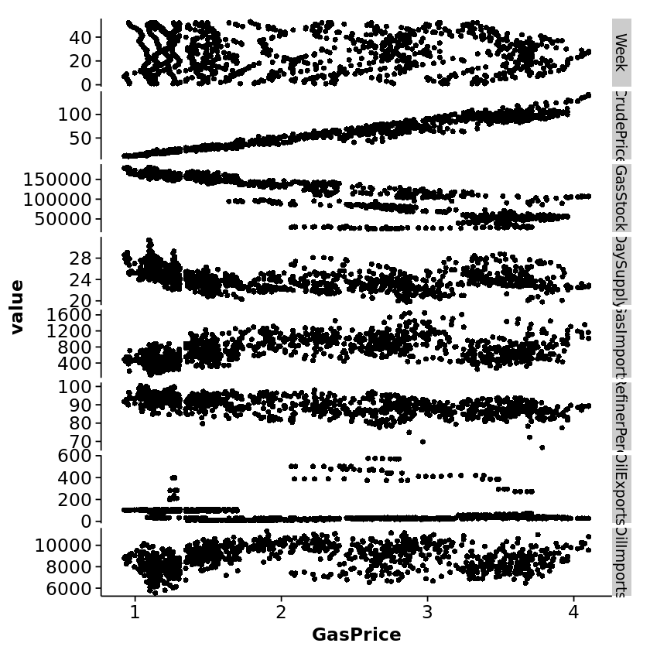
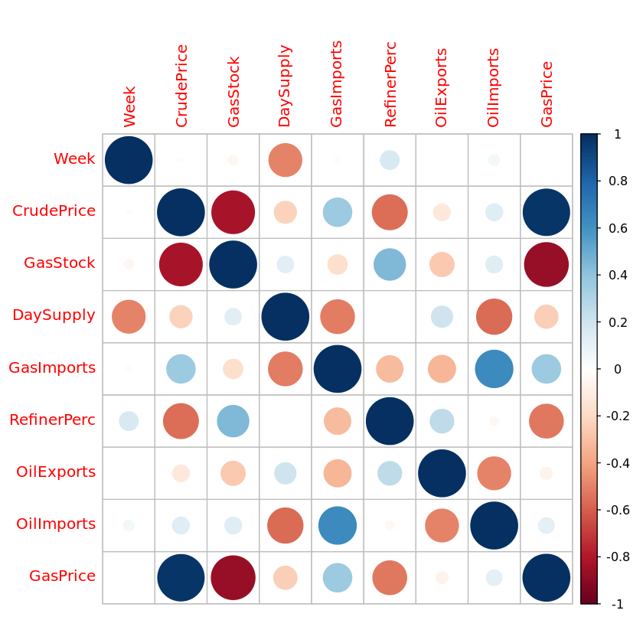
Feature Investigation
Patterns in features
Correlations between features

Slide 13
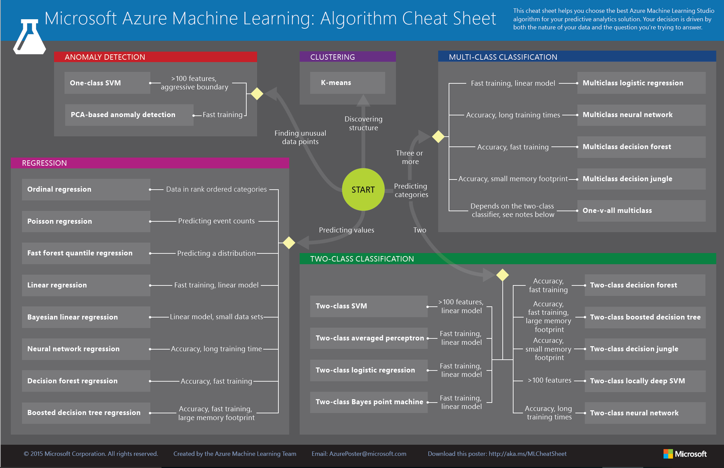

Slide 14
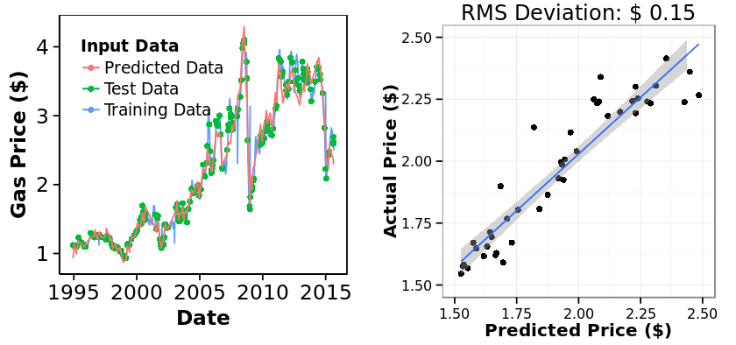
Simple Linear Regression
Performance on training data

Slide 15
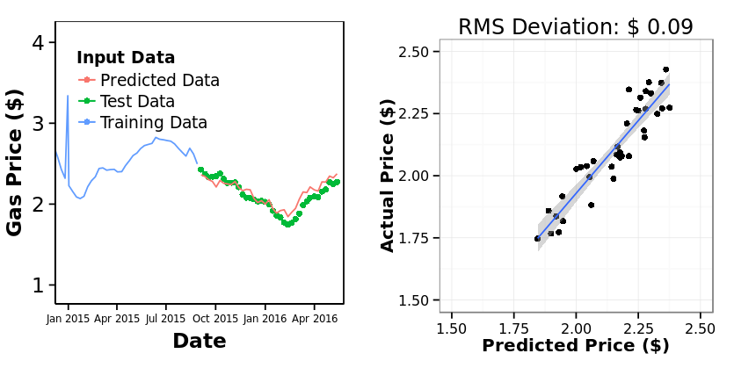
Simple Linear Regression
Performance on test data

Slide 16
Support Vector Machine (SVM) Regression

Slide 17
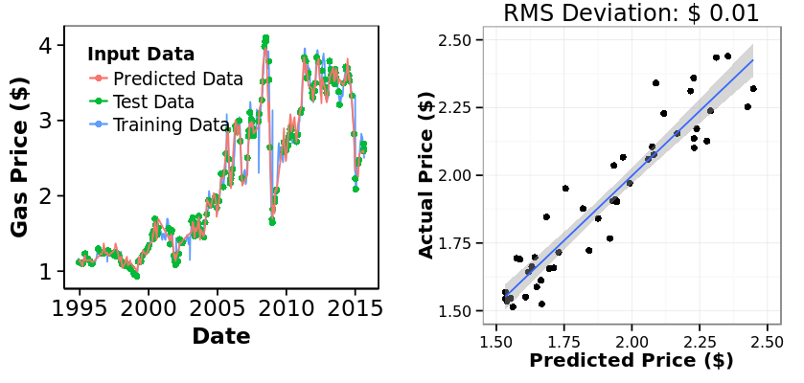
SVM Regression
Performance on training data
Linear Model

Slide 18
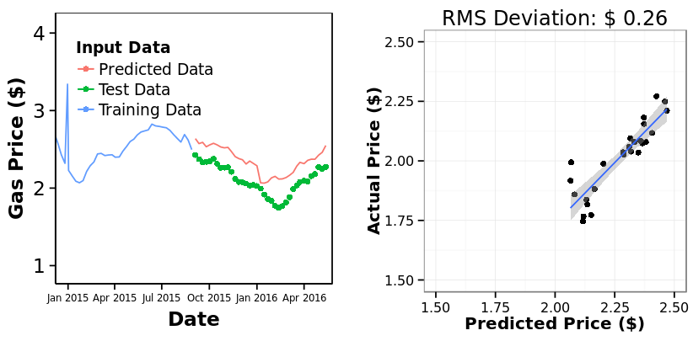
SVM Regression
Performance on test data
Linear Model

Slide 20
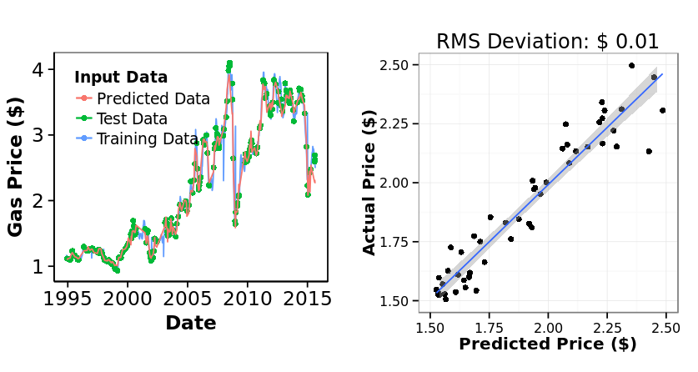
Boosted Decision Tree Regression
Performance on training data
Linear Model

Slide 21
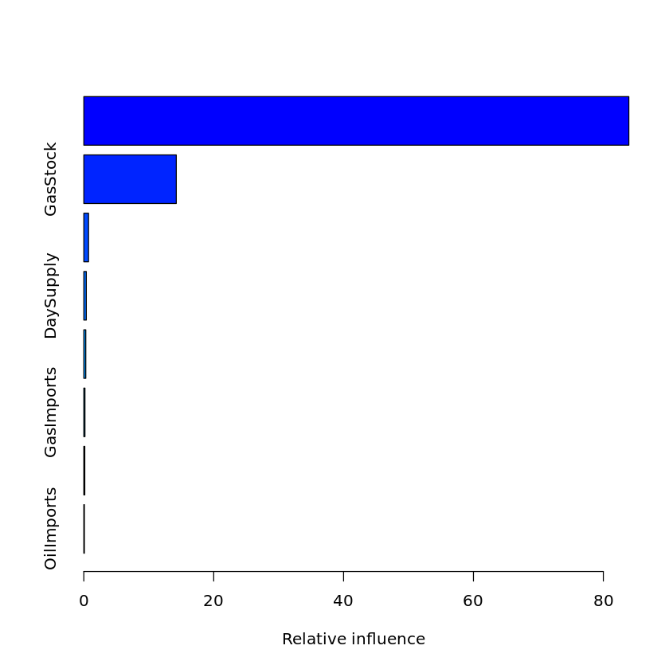
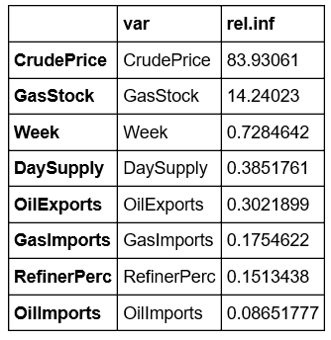
Boosted Decision Tree Regression
Tuned Hyperparameters:
Gaussian Distribution
Interaction Depth of 4 features
Minimum of 10 observations per node
200 Trees in forest
Shrinkage of 0.05

Slide 22
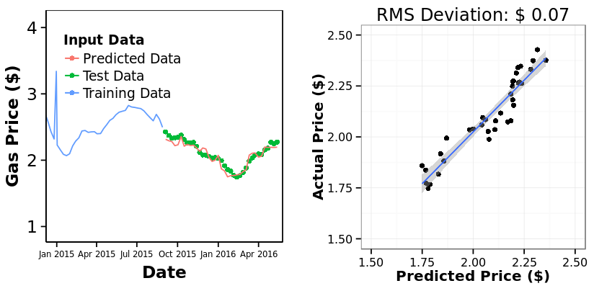
Boosted Decision Tree Regression
Performance on test data
Linear Model

Slide 23
Deploying Predictions

Slide 24
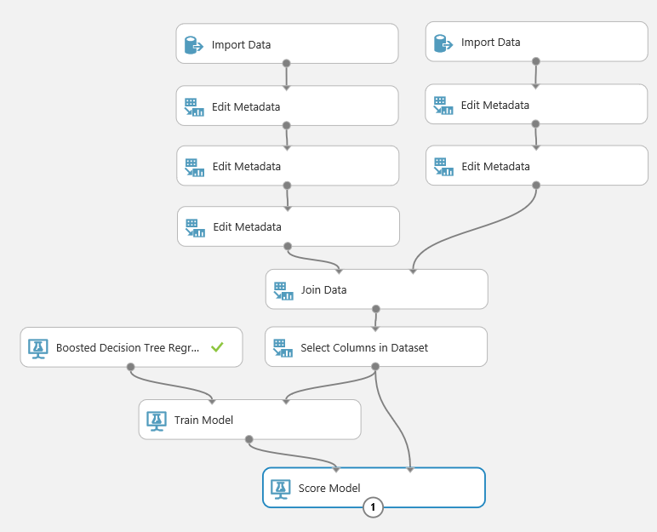
Historical
features
for
training
model
Historical
gas
prices
for
training
model
Training Model on Azure Machine Learning Studio

Slide 25

Azure Machine
Learning
Store Joined
Data
Train model using
historical data
Azure Data Factory
Deploy
trained
model
Azure Machine
Learning
Web Service

Slide 26
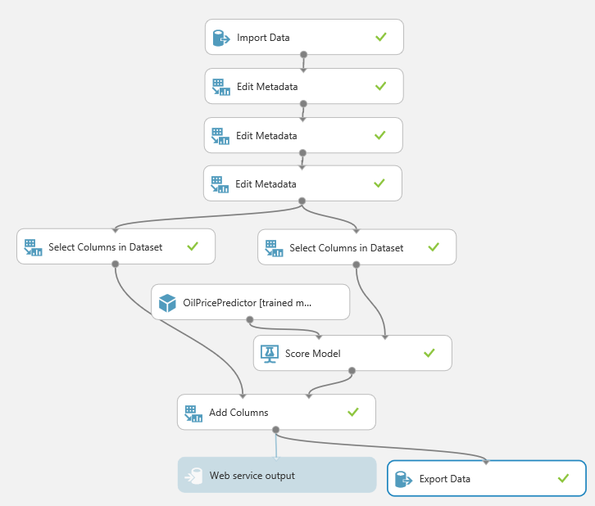
Recent
features
for
testing
model
Trained model deployed as web service on Azure Machine Learning Studio

Slide 27
Azure Machine
Learning
Store Joined
Data
Train model using
historical data
Azure Data Factory
Deploy
trained
model
Make predictions on current data
Azure Machine
Learning
Web Service

Slide 28
Azure Data Factory Pipeline
Azure Machine Learning
Score Data Activity

Slide 29
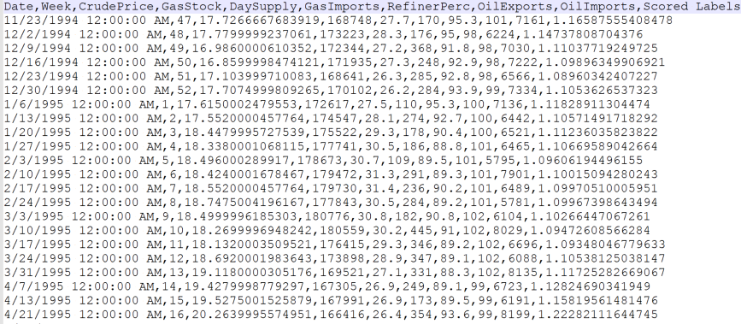
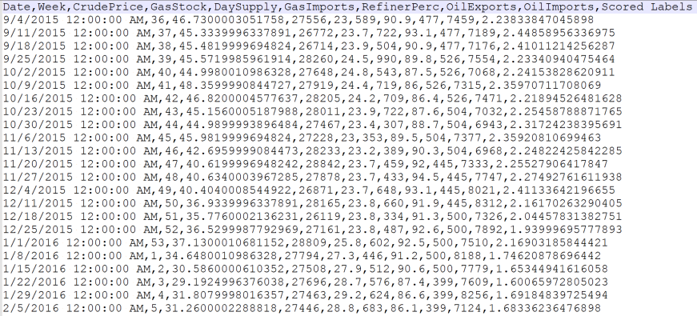
Output from Azure Machine Learning Model
Trained Scores
Predicted Prices

Slide 30
Azure Data Factory Pipeline
Deploy Results to
Azure SQL Server

Slide 31

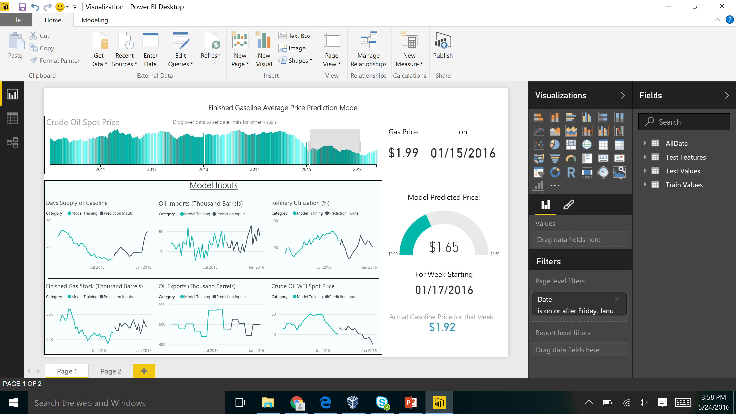

Slide 32
Summary
1. Azure Data Factory Batch Pipeline
3. Azure Machine Learning Trained Model
2. Good Performance on Test Data
4. Power BI End-User Dashboard with Prediction

Slide 33
Thank You!
Questions, comments, or further conversation:
Martin John Madsen
https://www.linkedin.com/in/martinjohnmadsen
Notes:
[Josh’s Slide]

